Slide 1

Intro to VR – Scripting 2
By: Jeremy Nielson

Slide 2
Minigame Preparation
For the rest of this scripting tutorial, we will be creating scripts to prepare the functional portion of the minigame.
The player will initially spawn in the area we have already created, and have the option to use the menu to either Exit Game or Start Game. Exit will simply close the application, where Start game will teleport the player to the game area.
The player will be tasked to shoot as many targets as they can within the allotted time, and their score will be displayed at the end.
There will be a number of scripts involved, some of which will have more in depth explanation and others that will be briefly covered.

Slide 3
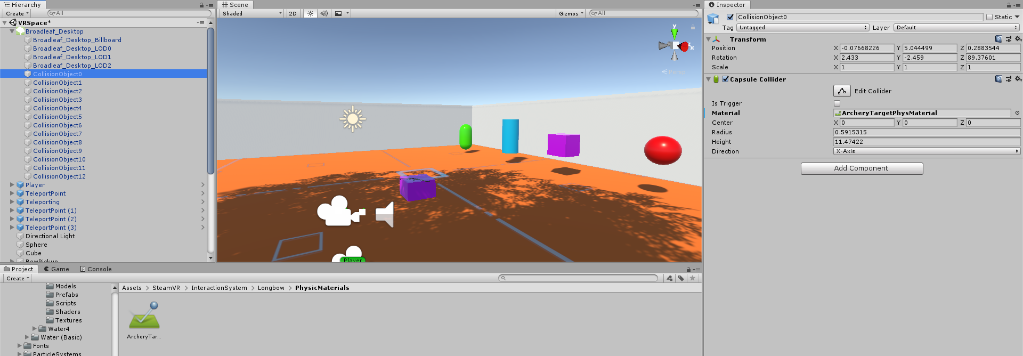
Initial World Building
Start by encasing the area we create into a four walled space.
Additionally, any object you want or expect an arrow to stick to, go ahead and add the same physics property we did with the four colored objects.
For the tree, attach this to each “Collision Object” inside of the object

Slide 4
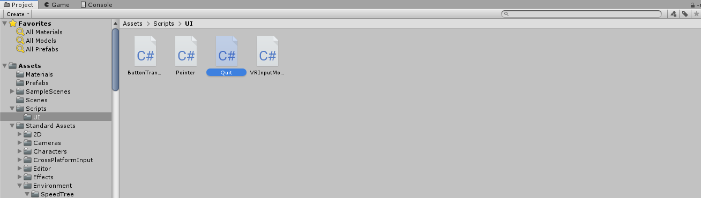
Quitting the Game/App
Start by selecting the button you wish to Exit the game.
Rename it to “Quit” or “Exit”, and change the text inside inspector to “Exit Game”
At this point you might notice we have quite a number of scripts for the UI. You can create a UI folder for the scripts to make it easier to find in the future.
Create a new C# script called Quit

Slide 5
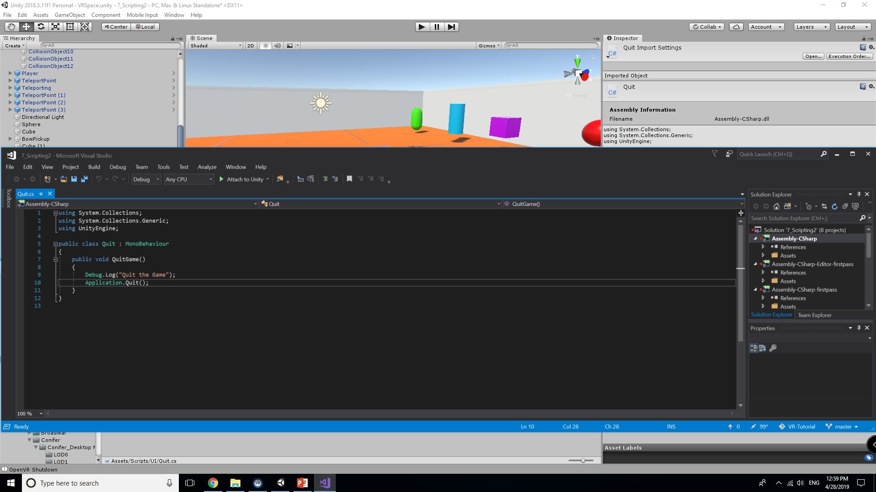
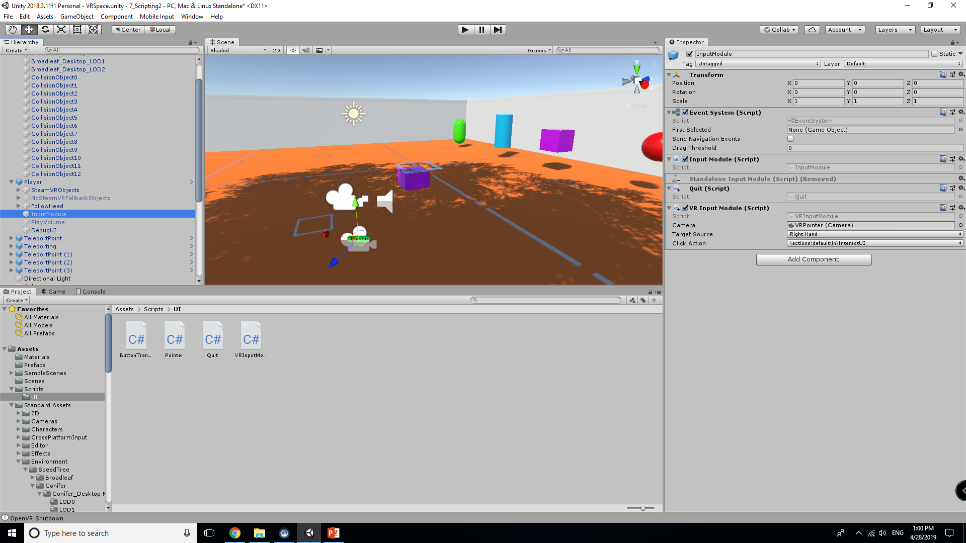
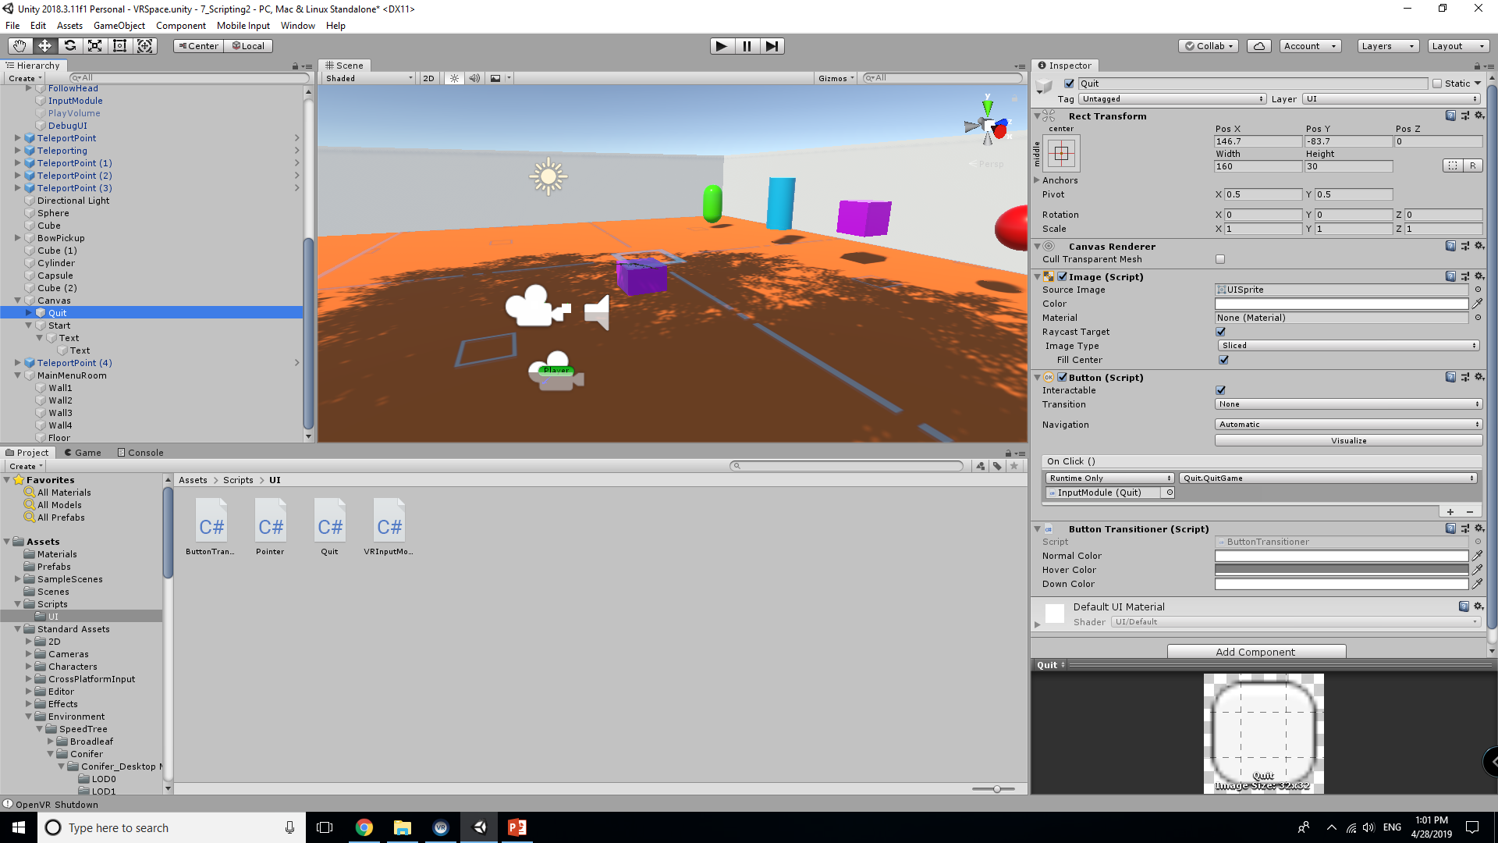
Quit Script
This script only prints a line to the console confirming the player quit and then subsequently quits the game.
Once written, attach it to the InputModule on the player. We will need to add functionality to the specific button for this to run onClick.\
In Quit button, under Button (Script) add a new OnClick function using the InputModule, then select Quit.QuitGame

Slide 6
Debug.log
The line Debug.log() operates in a similar fashion to how Print() is working for us in the other script. This however cannot be referenced as it is used to confirm the Exit worked as expected.
This is good enough for us. If you would like to test it ingame, you will need to deploy a build and run the application.

Slide 7
Before “Start Game”
There are a number of aspects we will need to address before we can work on the game itself.
We need the user’s view to fade to black after selecting start.
The user must then be teleported to the game area
There needs to be a HUD to track score and time.
Keeping these factors in mind, we are going to focus on the first two elements and address the third separately.

Slide 8
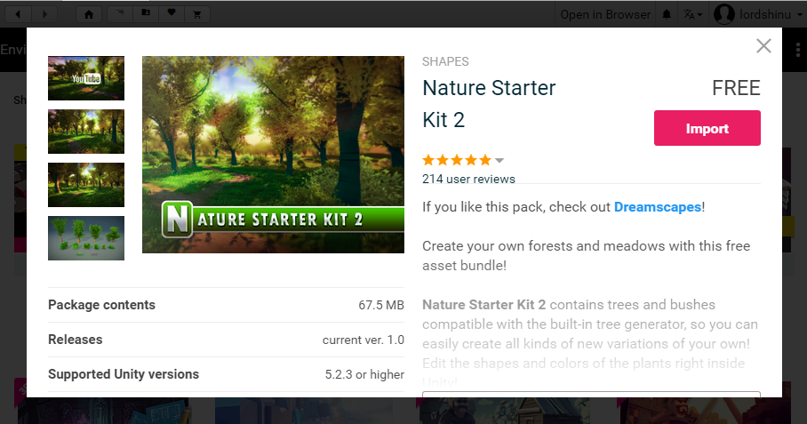
First things first…
We require an additional scene. This is where our minigame / the game world will be located. To speed things up, we will be grabbing a free asset from the Unity Store for the time being.
You should see Nature Starter Kit V2 under Environments. At the time of this tutorials creation it was the third on the list

Slide 9
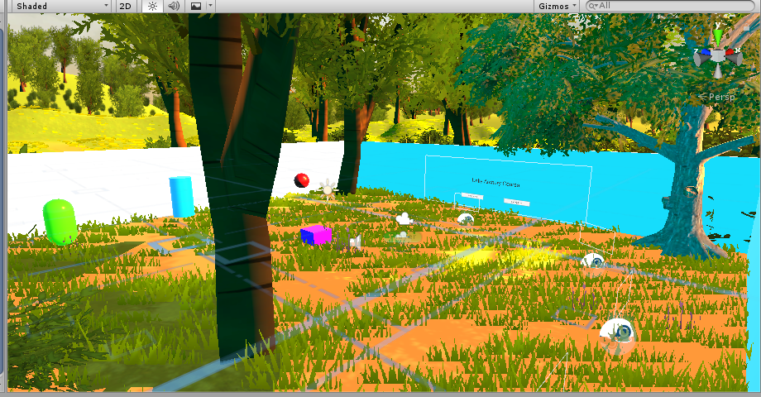
Adding new scene
Once imported, there should be a scene folder with a scene named Demo. Add this to the Heirarchy. Once added you will notice both your world and the new scene exist at the same time.
Right Click Demo and unload scene.
Additionally you can rename Demo in your assets to something more meaningful, such as Minigame

Slide 10
Start Script
We will be handling a few things inside this script that will essentially load and unload both world spaces while ensuring the transition is smooth.
When starting the game, the screen will fade to black, allowing the current world to be unloaded, the pointer to be disabled, and the new world to be loaded before fading back.
The reverse happens when loading out of the game
We may add additional features to this script as we code for the minigame
Go ahead and create a new script called StartScript
We will cover the Restart function in the next tutorial

Slide 11
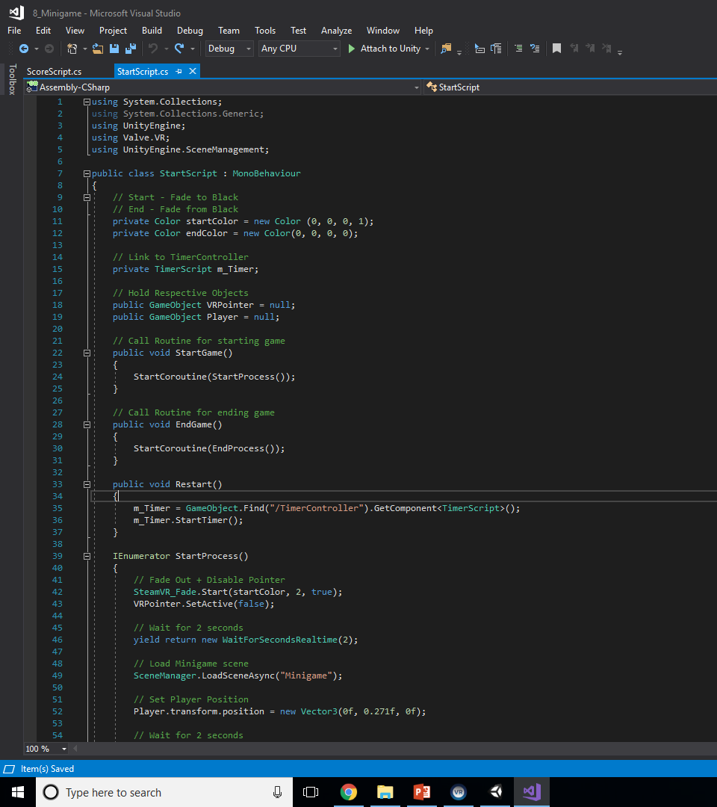
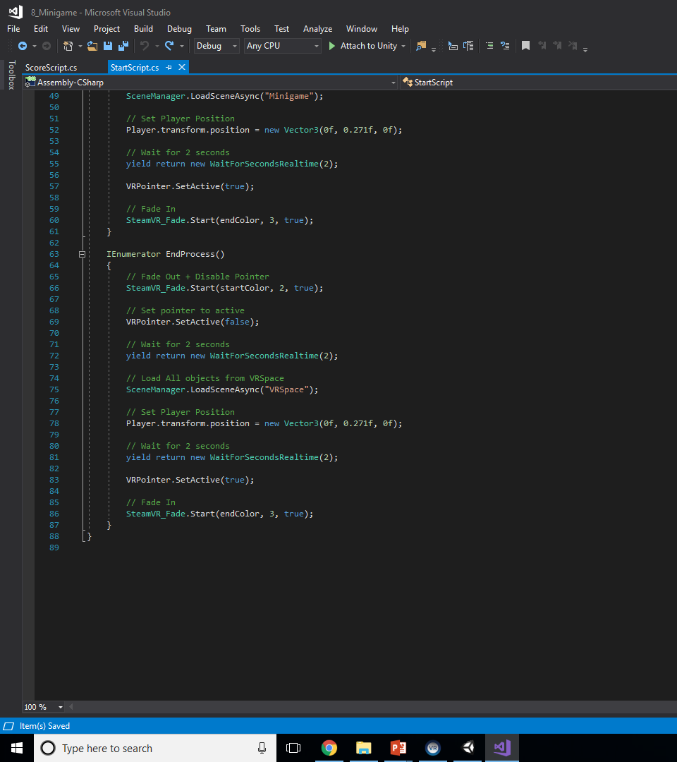

Slide 12
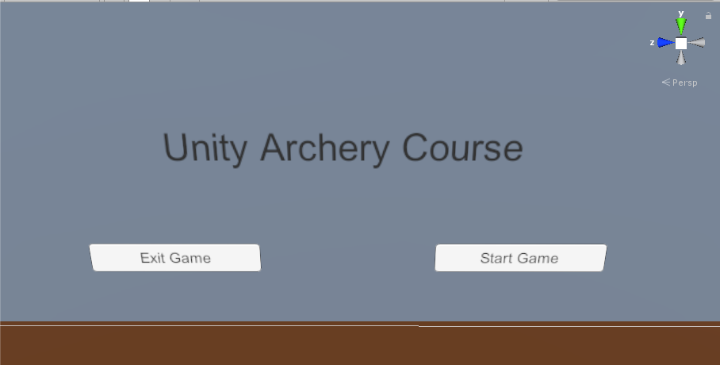
Your Main Menu
The main menu should look similar to the one below. You can add text to the Canvas to give the game a name. Be sure to name the buttons Start and Quit if you haven’t at this point.

Slide 13
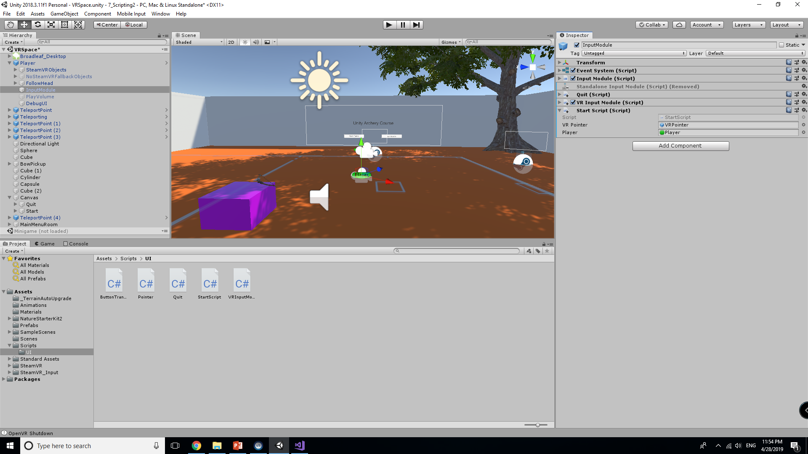
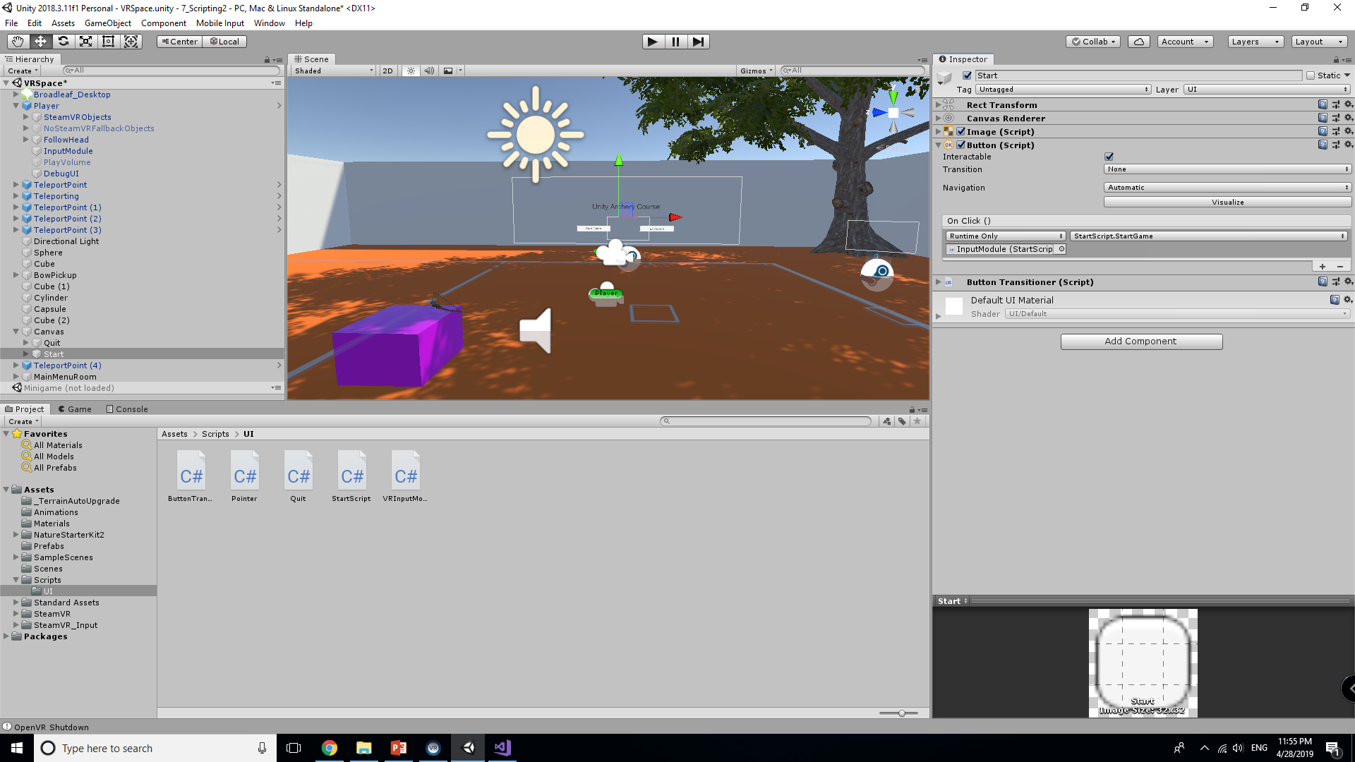
Start Button
As we did with onClick for the quit button, we need to attach the start script to the InputModule.
Set the Player and VR Pointer to their respective game objects.
Following this, set the Start button OnClick function to the StartGame Function of the StartScript

Slide 14
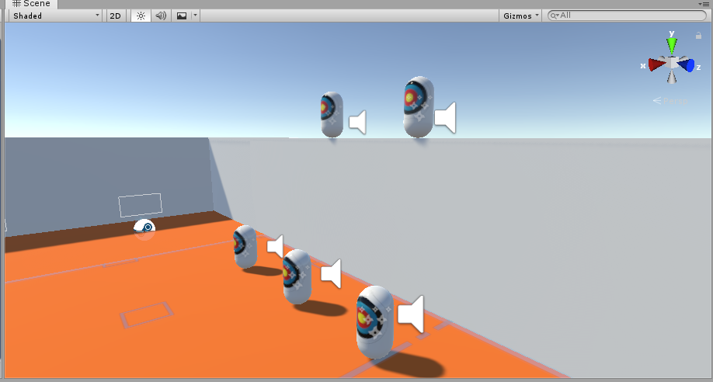
ArcheryWeeble
Go into Assets > SteamVR > InteractionSystem > Longbow > Prefabs > ArcheryWeeble
We will be using these as one of the targets in our minigame. Place a few in the VRSpace to test and see how they function

Slide 15
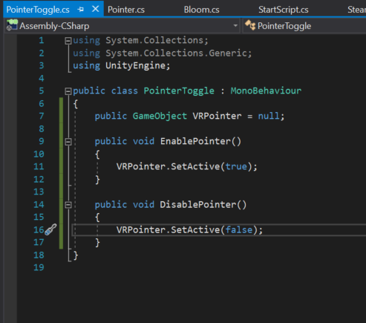
PointerToggle Script
One thing to address that needs to be attached the bow is a way to toggle the pointer once the bow has been equipped.
The pointer does not specifically point in the direction of the arrows. We need to rectify this.
Create a new pointer script that will be attached to the InputModule

Slide 16
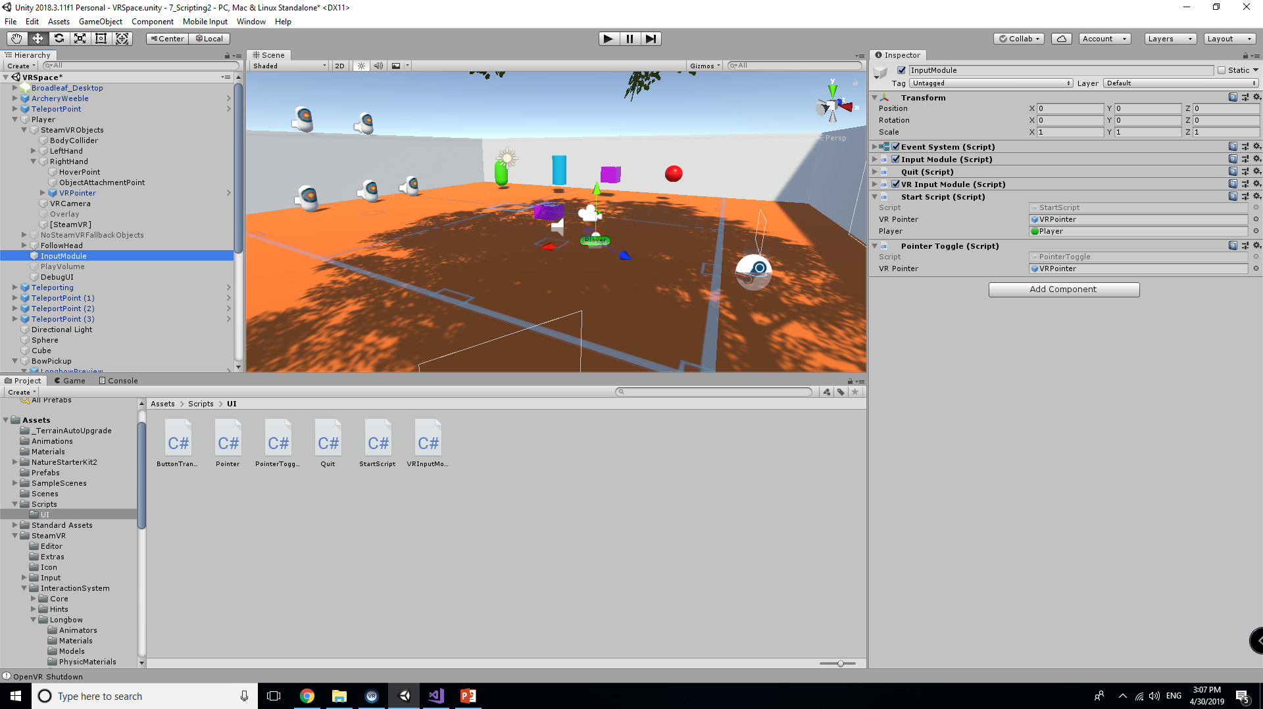
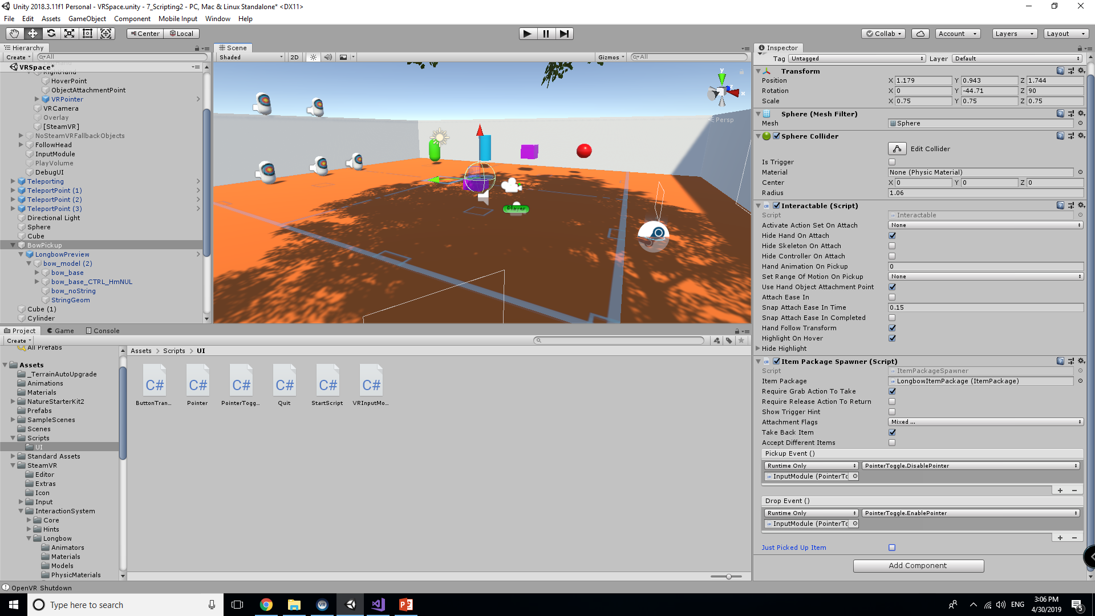
Attachment and Setup
Follow the two images below. You will want to select the functions on BowPickup

Slide 17
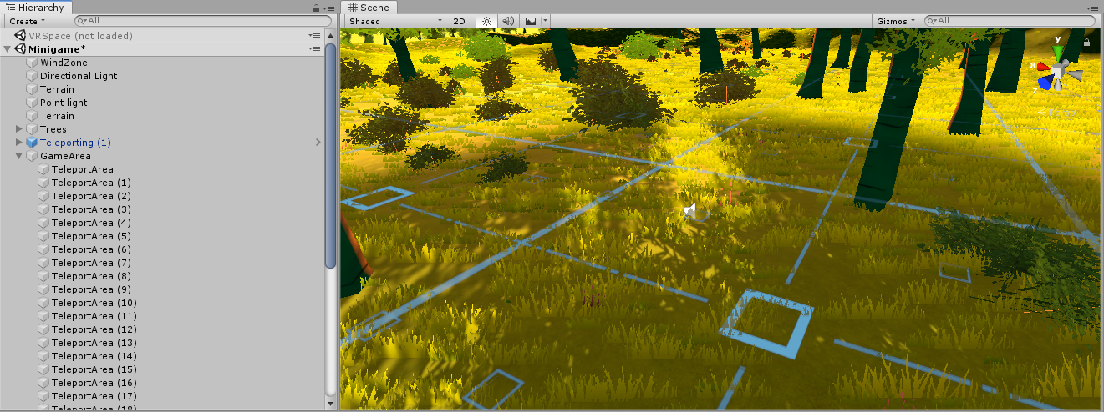
Before Testing
Remove the Main Camera found in Demo/Minigame. We also need to add teleporting and the teleport areas to the map so the player may explore.
It is recommended if you add teleporting areas you add multiple smaller ones so the player can easily see the grid better. They may need to be raised since the terrain is uneven.

Slide 18
BowPickup in Minigame
Simply copy and paste the BowPickup and its cube over to the Minigame and place it at the spawn point. If the script was followed correctly it should be near (0, 0, 0).
Also, be sure to increase the pick up radius of the bow sphere to ensure you can grab it at a distance that feels comfortable
At this time you can also add the bow physics object to the trees and environment as you see fit.

Slide 19
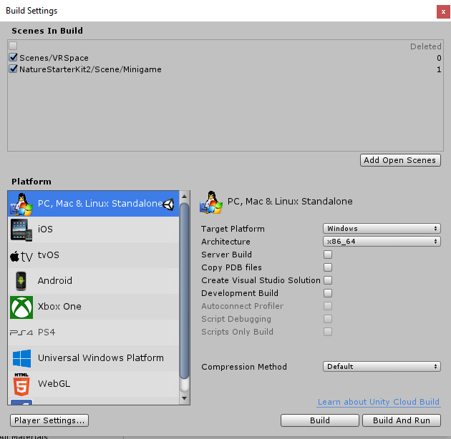
Final Note
MAKE SURE TO UNLOAD THE MINIGAME SCENE AND LOAD THE VRSPACE.
Having both open does not help you.
Add the new scene to your build before testing to ensure it is included. This is more useful for when you create standalone builds later in development.
IF you don’t remember, you can find Build Settings under File > Build Settings

Slide 20
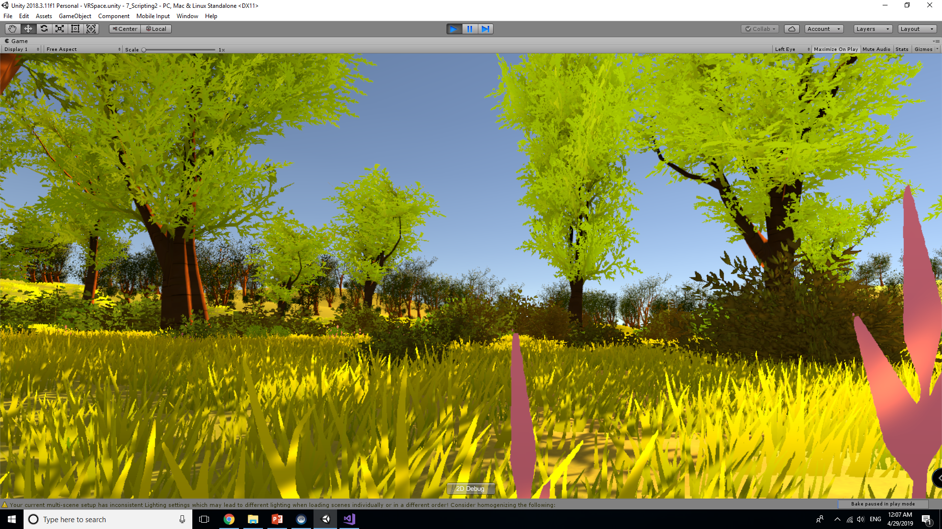
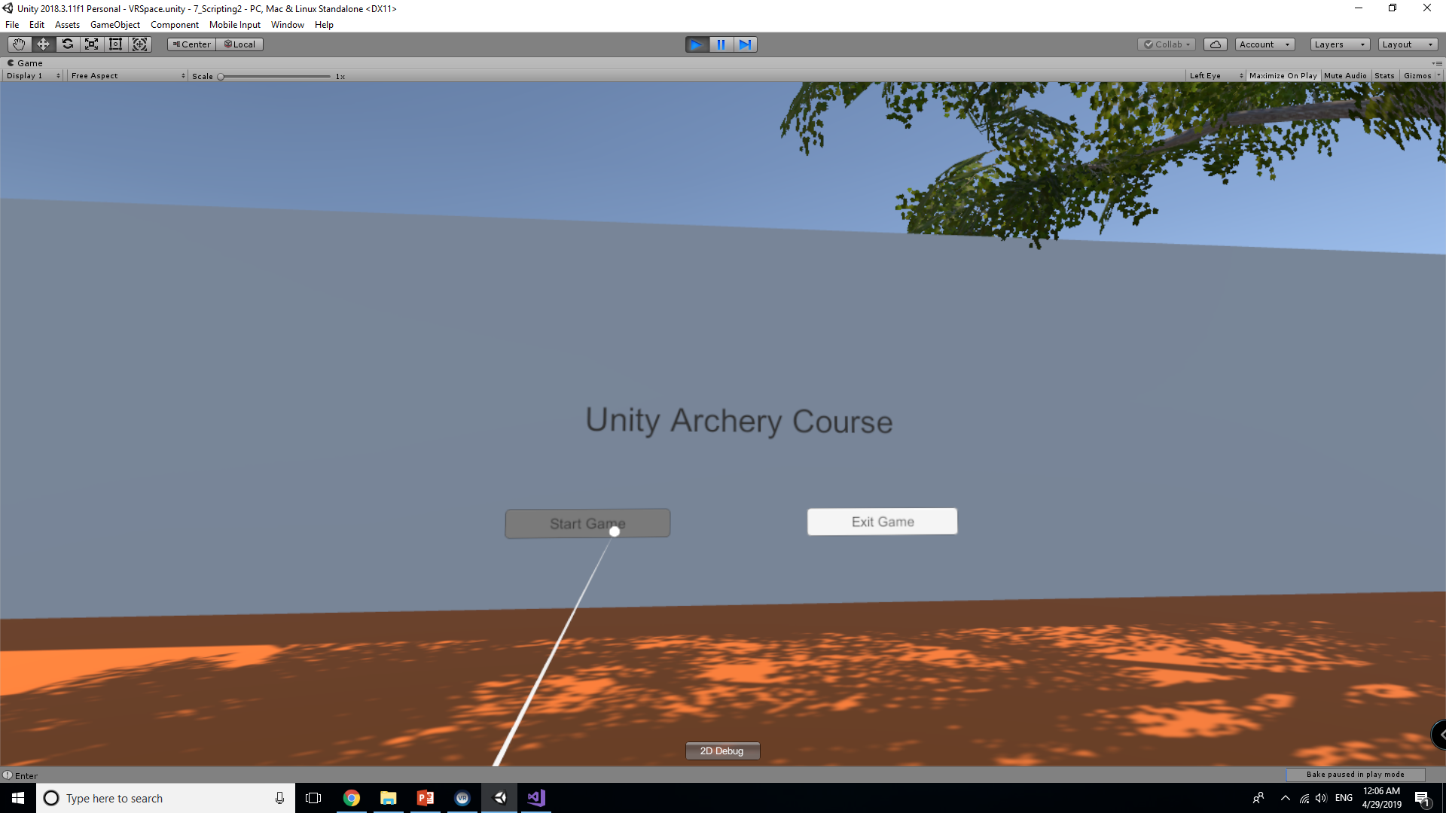
Current Progress
You should now after selecting start be able to warp from the Main Menu to the Game Area

Slide 21
Looking Ahead
The next part we will discuss creating a small game using the mechanics we have implemented.
So far we have:
A starting area that acts as a simple tutorial on the mechanics.
A main menu with a pointer system that is simple to understand.
A separate scene to handle the minigame.
We will aim to create a timer, score system, and end game handler to return to the main menu. There is a ton that is possible when building with Unity, but you should leave this with the fundamentals that you will need to succeed.

